Slide 2
Continuous Variable
Categorical Variables
Classification Variables

Slide 3
Deep learning is a subset of machine learning that uses artificial neural networks to model and understand complex patterns in data.
It is particularly powerful for tasks involving large datasets and high-dimensional data, such as image recognition, natural language processing, and speech recognition.

Slide 4
Artificial Neural Networks (ANNs)
Classification
Regression
Convolutional Neural Networks (CNNs) -> input data were in the format of images and videos
Recurrent Neural Networks (RNNs) -> NLP + Time Series based data analysis

Slide 5
TensorFlow - Google
Pytorch - Facebook

Slide 6
A perceptron is the simplest type of artificial neural network (ANN) model, representing a single neuron.
It was first introduced by Frank Rosenblatt in 1958 as a binary classifier, which means it can classify input data into one of two categories.

Slide 7
Input Layer: The perceptron receives inputs, each of which is associated with a weight. The input could be features of data, such as pixel values for an image or attributes in a dataset.
Weights: Each input is multiplied by a weight. These weights represent the importance of each input to the final decision.
Bias: An additional parameter, bias, is added to the weighted sum of inputs to shift the decision boundary and help the model handle cases where inputs are zero.
Activation Function: The perceptron applies an activation function (typically a step function or threshold function) to the weighted sum of inputs plus bias. If the result is above a certain threshold, the output is classified as one category (e.g., 1); otherwise, it is classified as the other category (e.g., 0).

Slide 8
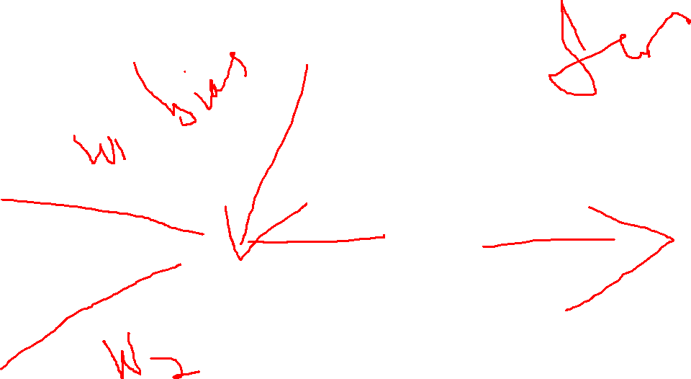

Slide 9
Limitations in single layer perceptron
Linearly Separable Data: The perceptron can only solve problems where the classes are linearly separable (i.e., they can be separated by a straight line in 2D space or a hyperplane in higher dimensions). If the data is not linearly separable, the perceptron will fail to converge.
Non-linear Problems: The perceptron cannot solve non-linear problems, such as XOR, where a linear decision boundary is insufficient.

Slide 10
Multi Layered Perceptron
Forward Propagation
Backward Propagation
Loss Function
Optimizers
Activation Fucntion

Slide 11
Forward Propagation
Purpose: During forward propagation, the input data is passed through the network layer by layer. Each layer applies weights, biases, and activation functions to the input data to generate an output (predicted result).
Process:
The input features are multiplied by the corresponding weights and then added to the bias.
The result is passed through an activation function to introduce non-linearity.
This process continues through all the layers until the output layer produces the final prediction.

Slide 12
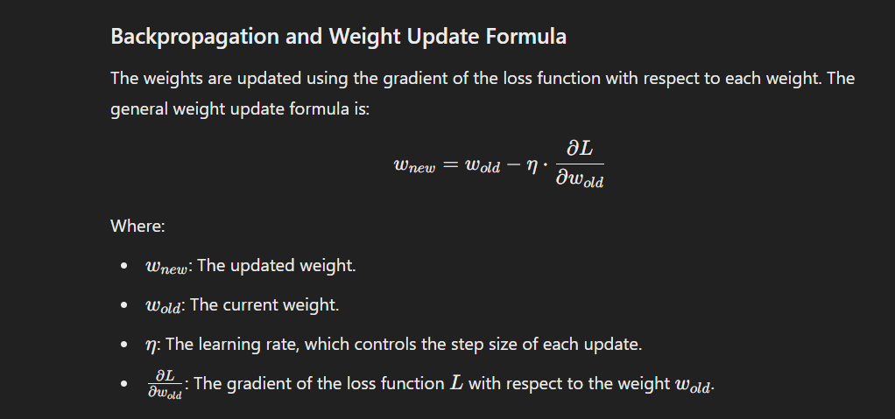

Slide 13
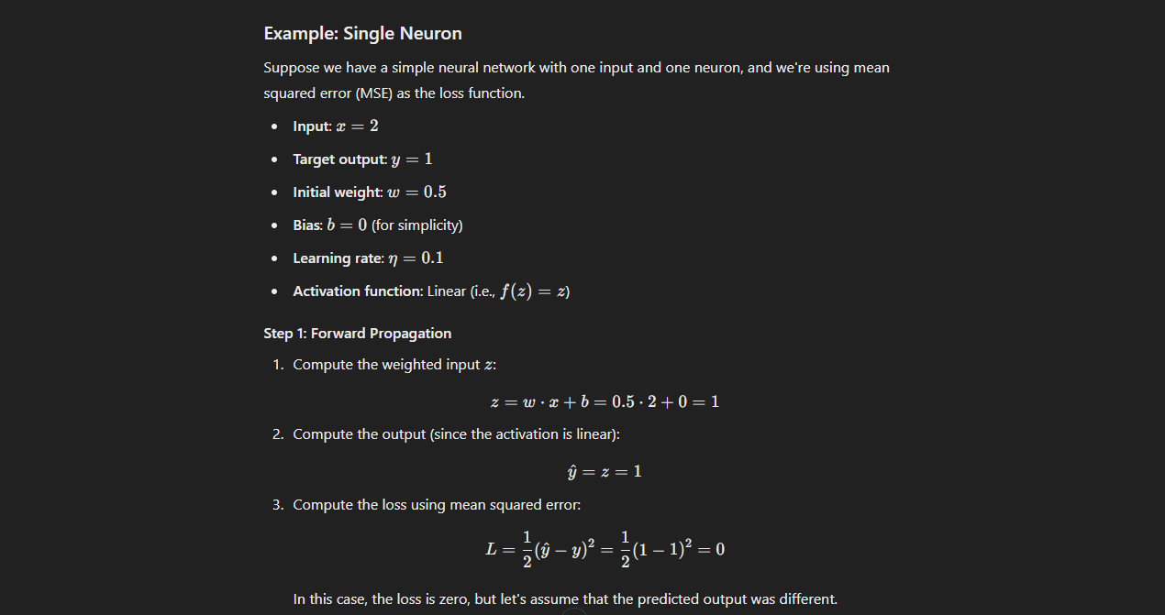

Slide 14
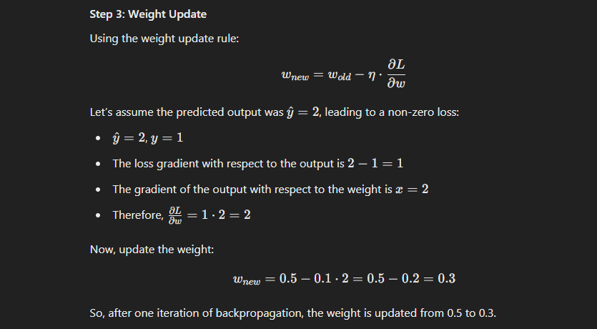

Slide 15
Backward Propagation
Purpose: Backward propagation (backpropagation) is used to minimize the error in predictions by adjusting the weights and biases in the network. This is done by calculating the gradient of the loss function with respect to the weights using the chain rule of calculus.
Process:
The network computes the error by comparing the predicted output to the actual target (using a loss function).
It then propagates this error backward through the network, layer by layer.
The weights are updated based on the calculated gradients and the learning rate, ensuring that the network gradually improves its performance on the training data.

